Slide 1
BioPython
Manipulating Sequences
& Retrieving Data from Entrez

Slide 2
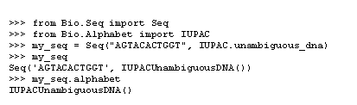
Specify Alphabets P. 39

Slide 3
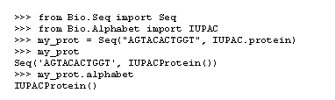

Slide 4
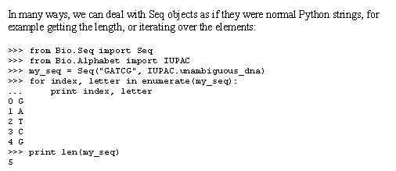
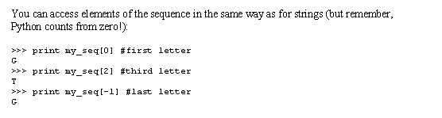
Sequences as strings:

Slide 5
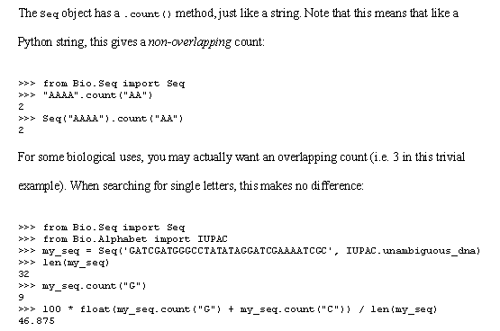
P. 40

Slide 6
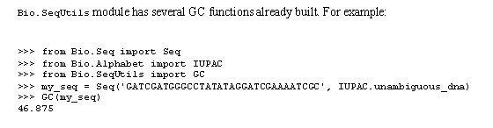
Or u can use Bio.SeqUtils module ☺

Slide 7
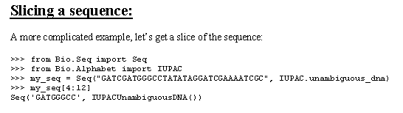
P. 41

Slide 8
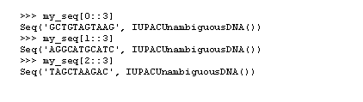
Stepping P. 41
The start
The size of step

Slide 9
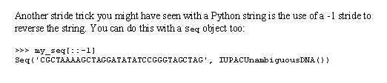
Reversing the string ! P. 42

Slide 10
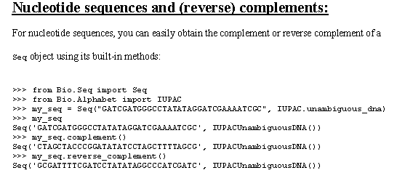
P. 43

Slide 11
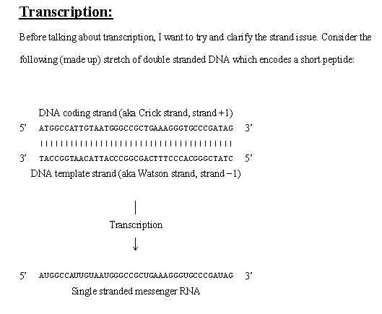
P. 44

Slide 12
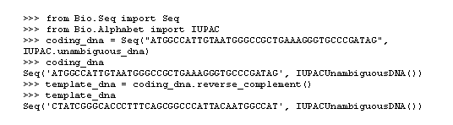

P. 44

Slide 13
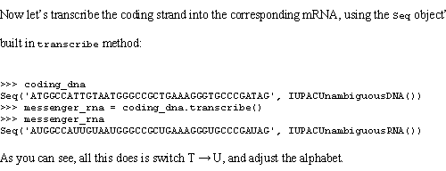

Slide 14
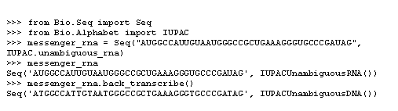
Back Transcription

Slide 15
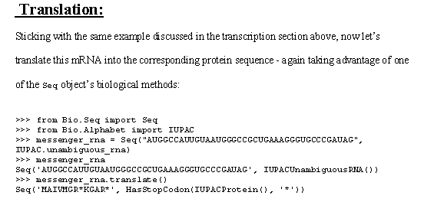
P. 46

Slide 16
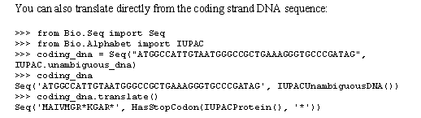

Direct translation

Slide 17
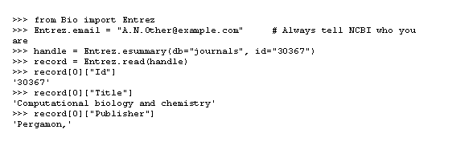
Retrieving Summaries from Entrez ESUMMARY

Slide 18

Downloading full records from Entrez EFetch

Slide 19


